Slide 1


Ethereum isn’t
Turing Complete
and it doesn’t
matter anyway
Andrew Miller
Aug 2, 2016
IC3 NYC Blockchain Meetup

Slide 2


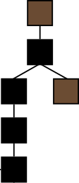
Digital currency is just one application running a top a blockchain
Blockchain
Users
Money
Account Balances
Alice: ฿10
Bob: ฿15
Carol: ฿120

Slide 3
Blockchain: a virtual trusted third party
Smart contracts: programs running on a blockchain
Blockchain
Users
Money
Smart Contracts
Storage
Code
Data
Notes:
Smart contracts let us build new financial tools

Slide 4
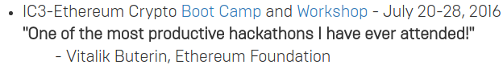
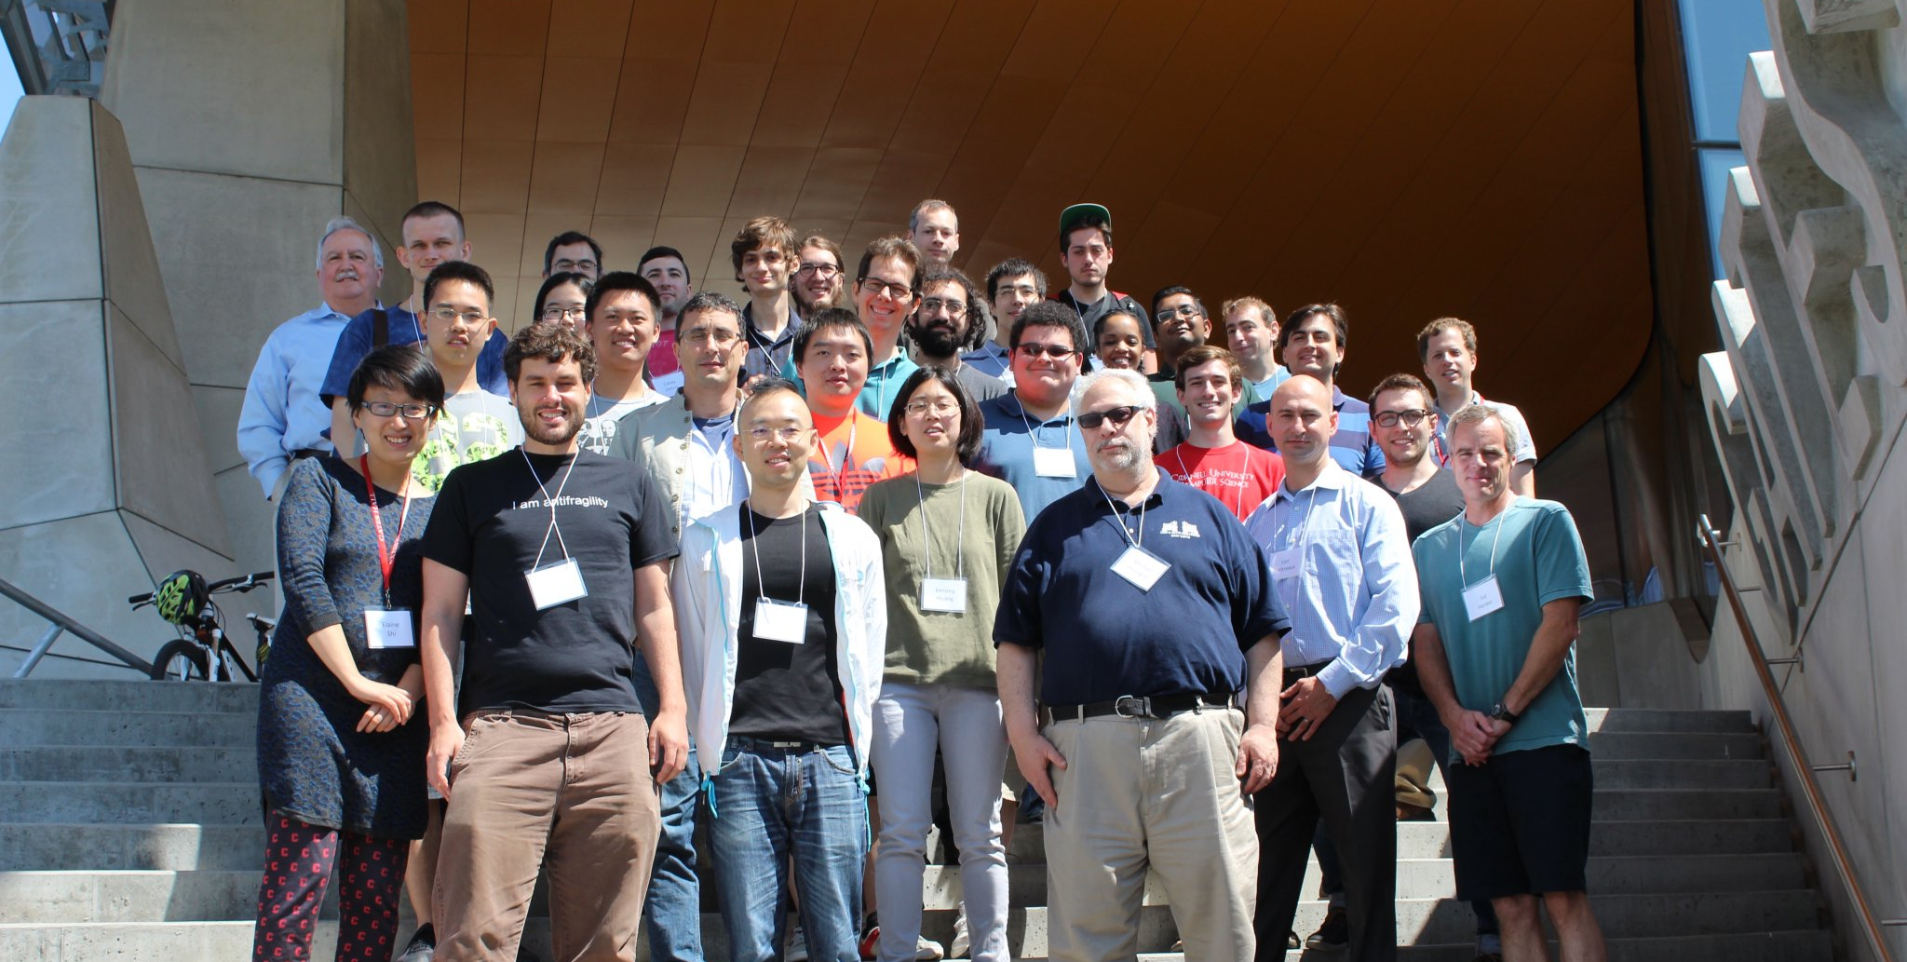

Slide 5

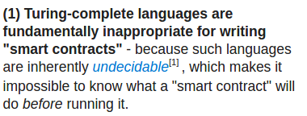

Slide 6
Turing Machines
Wow! The worst computing model ever!
“Hello World” in (high level) Turing Machine code
--<-<<+[+[<+>--->->->-<<<]>]<<--.<++++++.<<-..<<.<+.>>.>>.<<<.+++.>>.>>-.<<<+.

Slide 7
Turing Machines are universal*
* … for computable functions
Church-Turing thesis:
“All reasonable computing machines can be simulated* by each other”
*With polynomial asymptotic efficiency

Slide 8

In computability theory, the halting problem is the problem of determining, from a description of an arbitrary computer program and an input, whether the program will finish running or continue to run forever.

Slide 10

Ethereum isn’t Turing complete
Actually, the Ethereum Virtual Machine always halts after a bounded time.

Slide 11
- Incorrect logical statement. No points awarded.
- There exist SOME programs we can’t decide, but in practice these programs are NOT the programs we care about.

Slide 12
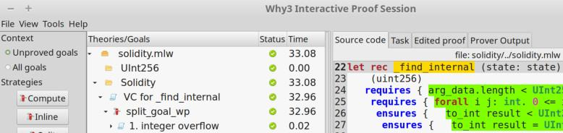
Halting problem is not an excuse to avoid formal analysis
Many formal analysis tools apply to Turing complete languages
No efficiently* solvable problem requires Turing completeness
*polynomial time

Slide 13
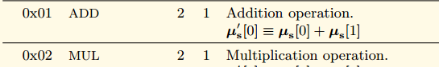
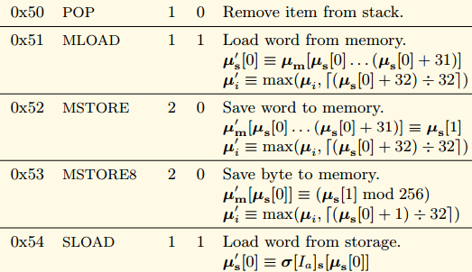
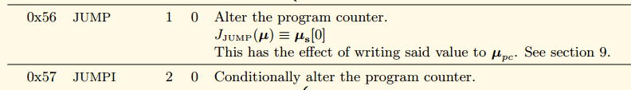
Turing Machines are NOT Universal for Smart Contracts
Neithereum - a Turing complete and yet utterly useless smart contract system

Slide 14

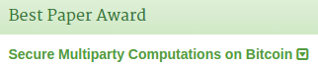
Ethereum is more powerful than Bitcoin for reasons that have nothing to do with Turing completeness
Due to the limitations of Bitcoin’s UTXO structure, even celebrated Bitcoin smart contracts are inefficient.
A fair lottery game with O(N³) collateral required

Slide 15
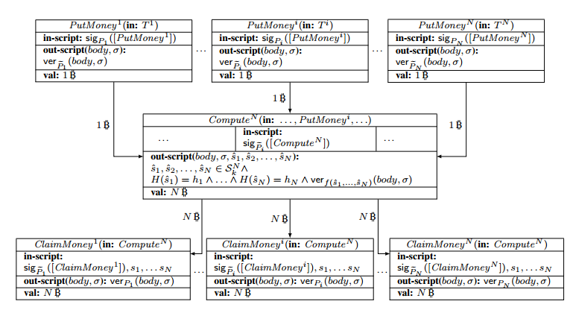
Each of N parties deposits N² coins (N³ in total) and commits to a random string
If any party does not open their commitment in time, they forfeit their deposit, others compensated

Slide 16

Cheaper lottery on Ethereum using persistent state
Winner gets N coins
Time 3
Open commitments, winner goes on to next round
If either party aborts, they do not advance.
Time 2
Time 1
Each party deposits 1 coin
Commits to a random string

Slide 17

Ethereum isn’t Universal - Contrived example
contract WantToPlayAGame {
int private switch = 1;
int private balance = 0;
function doubleMyMoney() onlyAlice {
assert msg.value == 1000000;
assert block.number < B;
if (switch) balance = 1000000 * 2;
}
function withdraw() onlyAlice {
assert block.number >= B;
send(msg.sender, balance);
}
function tricky() onlyJigsaw { switch = 0; }
}
Only safe to call doubleMyMoney if “switch” is set.
There is no way to inspect switch!
- Cannot observe effects this block
- Cannot check if 1st tx in block
- Cannot load current block hash

Slide 18
Moral of the story
Difficult tradeoffs between expressiveness and transparency in programming language design
there isn’t one

Slide 19


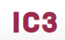

HAWK:
Privacy-Preserving Smart Contracts
Ahmed Kosba, Andrew Miller, Elaine Shi, Zikai Wen, Charalampos Papamanthou
IEEE S&P, 2016 https://eprint.iacr.org/2015/675

Slide 20
Blockchain: a virtual TTP - correctness, not privacy
Smart contracts: programs running on a blockchain
Blockchain
Users
Money
Smart Contracts
Storage
Code
Data
Notes:
Smart contracts let us build new financial tools

Slide 21
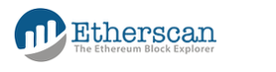
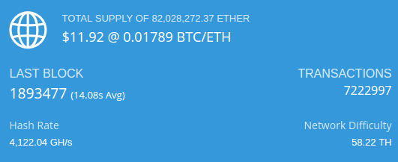
~$1B Market Cap
July 16, 2016
Contracts
98326

Slide 22
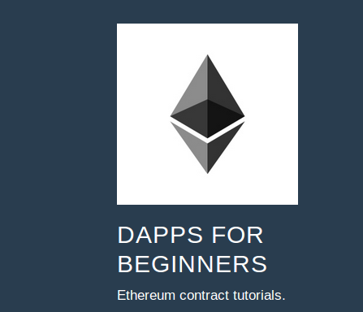
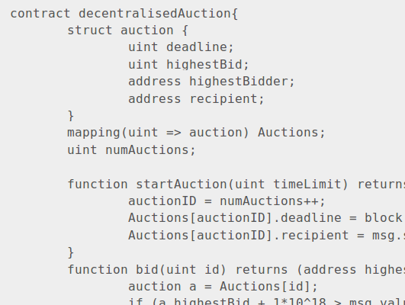
Notes:
Using these tools to build prototypes.
“Decentralized applications for beginners”.
The promise is that anyone can design dapps, it’s not much harder than using a programming language tool. Looks a little bit like C#, comes with a suite of debugging simulation tools.
A significant number of these blockchain investments essentially have domain experts, familiar with busineeds needs or finance, using tools like these to prototype “blockchain” versions of existing financial instruments or processes.
The tutorial includes auctions, crowd funding, tradeable stock-like assets.

Slide 23
Big concern with smart contracts is privacy
- Code of the contract is public
- Data sent to the contract is public
- Money sent/received is public
Notes:
Blockchain guarantees correctness, not secrecy

Slide 24
Implications of privacy leaks
- What stocks you are invested in
- What risks you are hedging against
- An attacker can “front-run” your order

Slide 25


Naïve auction
1
Input
bids
Blockchain Contract
leaked
HAZARD
Winner pays 2nd price
Other bidders get refund
Seller receives 2nd price
2
Output
refunds
2nd price
Notes:
Concrete example of a contract: auction application The problem is that the blockchain guarantees correct execution, it does not guarantee any privacy.

Slide 26
Hawk:
a framework for privacy-preserving smart contracts
Main idea:
Use Zero-Knowledge Proofs (ZKP)
Prove statements about a ciphertext without revealing information about the plaintext

Slide 27
Privacy
Bitcoin
Zerocash
[BCG+14]
Programmability
Ethereum
Hawk

Slide 28

Hawk auction
Freeze
1
Commitment( , r ), ZKP
Blockchain Contract
Open
2
Encrypt_{Manager}( , r )
ZKP Parameters
3
Finalize
Encrypt_{User}( ), ZKP
Notes:
Say that blockchain verifies ZK poofs

Slide 29
Minimally trusted manager (i.e., auctioneer)
Not for correctness
Not for input independence
Not for the security of the currency
Not for fairness
Trusted only for posterior privacy in this contract
Could implement with MPC, hardware

Slide 30


Develop applications without thinking about crypto
Smart contract
program
Cryptographic
protocol
Hawk
Compiler

Slide 31
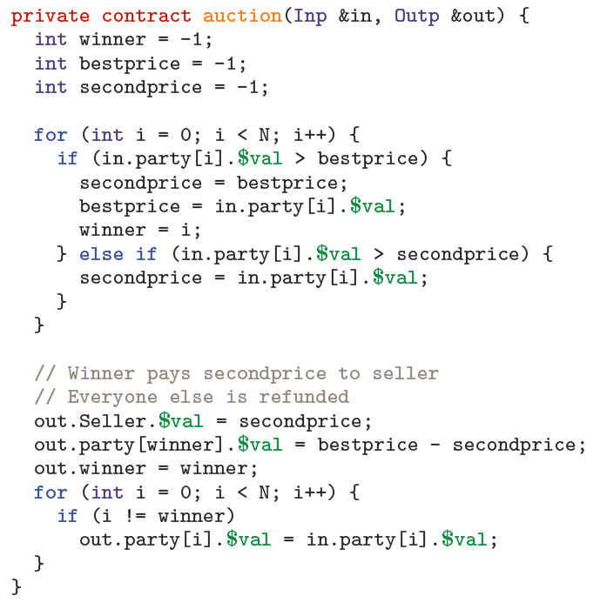
Sealed-bid auction

Slide 32
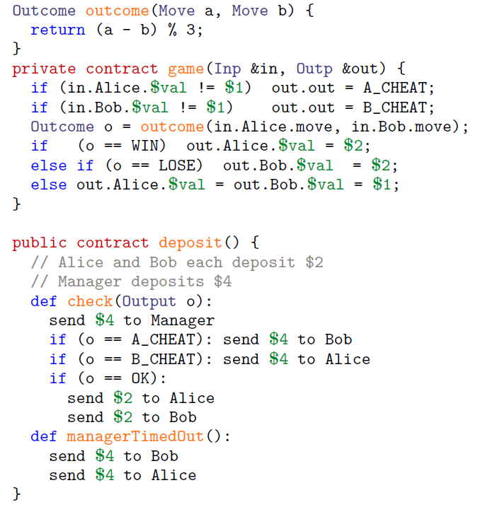
Rock-paper-scissors
Sealed-bid auction

Slide 33
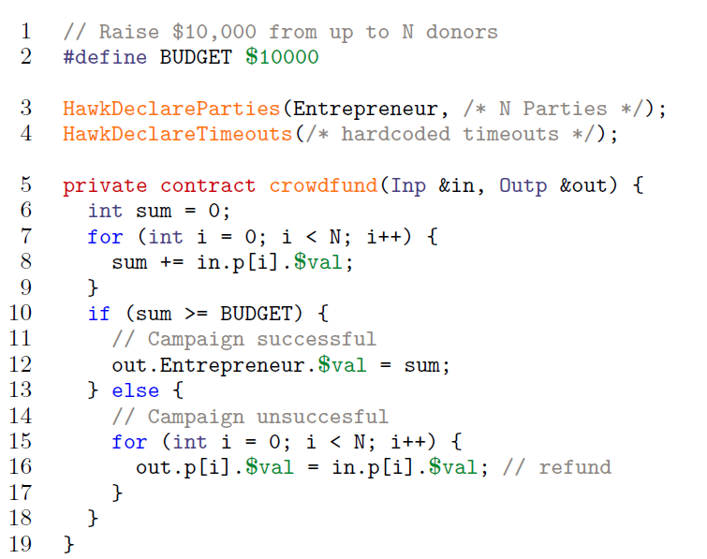
Rock-paper-scissors
Sealed-bid auction
Kick-starter

Slide 34
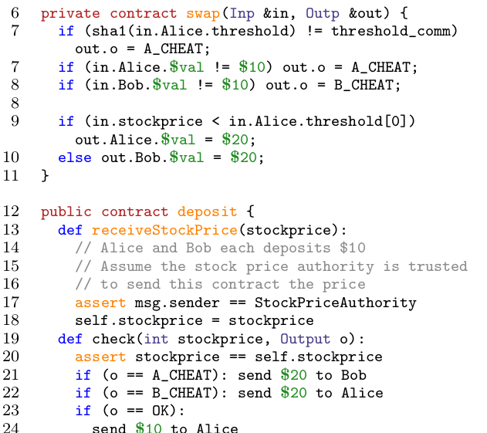
Rock-paper-scissors
Financial Swap
Sealed-bid auction
Kick-starter

Slide 35
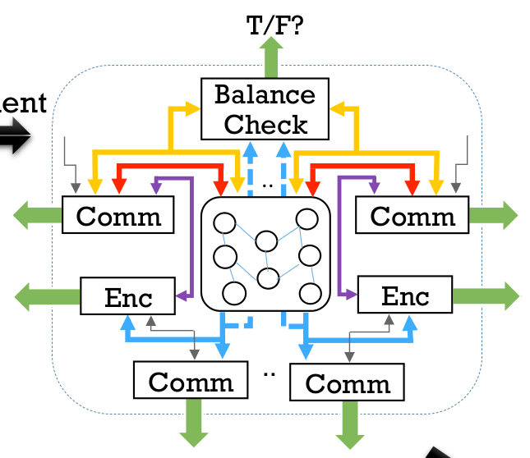
Hawk compiler
User Program
Step 1: User provided program compiled to arithmetic circuit
Pinocchio
[PGHR13]
Input data
Input value
Arithmetic Circuit
Output values

Slide 36
Hawk compiler
Step 1: User provided program compiled to arithmetic circuit
Step 2: Augment arithmetic with ZKP-friendly crypto
Notes:
What exactly do this systems do,
Explain what we’re putting together as a result.

Slide 37
Hawk compiler
Step 1: User provided program compiled to arithmetic circuit
Step 2: Augment arithmetic with ZKP-friendly crypto
Step 3: libsnark backend
[BCTV14]
Notes:
What exactly do this systems do,
Explain what we’re putting together as a result.

Slide 38
Performance
@ 112-bit security
100-user auction or crowd-funding
Auctioneer: 2.8 min
User: 40 secs (independent of # users)
On-chain cost: ≈ 1.5 seconds
≈ 220 kilobytes
Main overhead: ZK proofs

Slide 39
More in the paper:
- Formal models and proofs in UC
including multi-party variation
- Efficient UC-secure zero knowledge proofs
- SNARK-friendly cryptography
Software available:
jSNARK: http://oblivm.com/jsnark
Hawk: http://oblivm.com/hawk (soon)

Slide 40

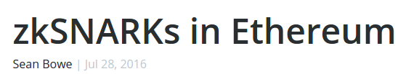

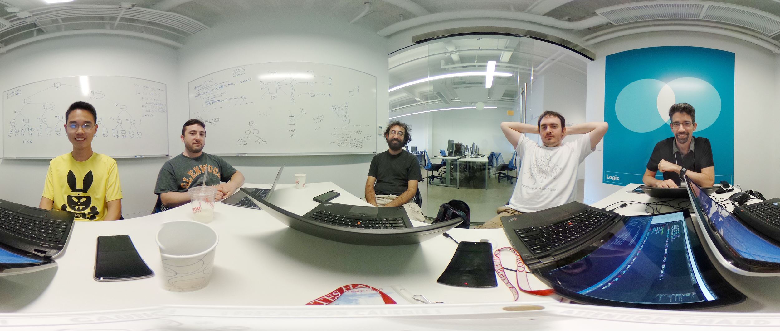

Slide 41


HAWK: Privacy-Preserving Smart Contracts
https://eprint.iacr.org/2015/675
Software available:
jSNARK: http://oblivm.com/jsnark
Hawk: http://oblivm.com/hawk (soon)
@socrates1024

Slide 43

Privacy-preserving Auction
Manager (PK_m)
Participant
Setup Contract
Auction Contract
Time
Start auction
Pay(deposit)
Set VKey
Freeze ( hidden coins ), proof
Freezing Time
Verify Proof
Freeze Hidden Coins
Opening Time
Send (Enc(PK_m, coin secrets)), proof
Verify Proof
New Hidden Coins , proof
Finalization Time
Verify Proof
Receive money back if not a winner
UnFreeze( hidden coins ) , proof
If manager does not finalize

Slide 44

Anonymous
Auction Manager
Public addresses that are used with only one contract
Anonymous
Participant
Mint
Pour
Create Contract
Auction Contract
Must mint and pour enough money for contract creation, deposit and gas
Pour
Mint
Start auction
Pay(deposit)
Send(Comm(P,v,nonce))
Pay(deposit)
Store Commitments
Send([value,nonce])
Pay(value - deposit)
Pour
Verify Commitments
End auction
Receive deposits back
except if a winner / cheater
Receive(deposit +
winners/cheaters deposit)
Identify Winners /
Cheaters
Pour
Mint
End auction
Receive(deposit + a ratio of
manager’s deposit)
Same contract as before .. Nothing special needed
Mint
Pour

Slide 45
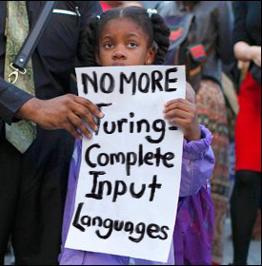
Weird Machines
The Language-theoretic approach (LANGSEC) regards the Internet insecurity epidemic as a consequence of ad hoc programming of input handling at all layers of network stacks, and in other kinds of software stacks.

